Slide 1
Meeting 8
Tuesday 27/02/2018

Slide 2
Agenda
Park model: test case
Sensitivity study
LES data & BEACon data
Calibration
Next steps

Slide 3
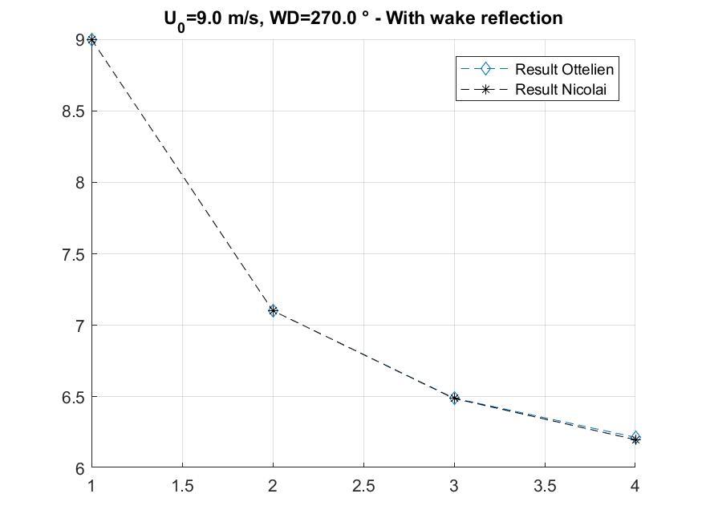
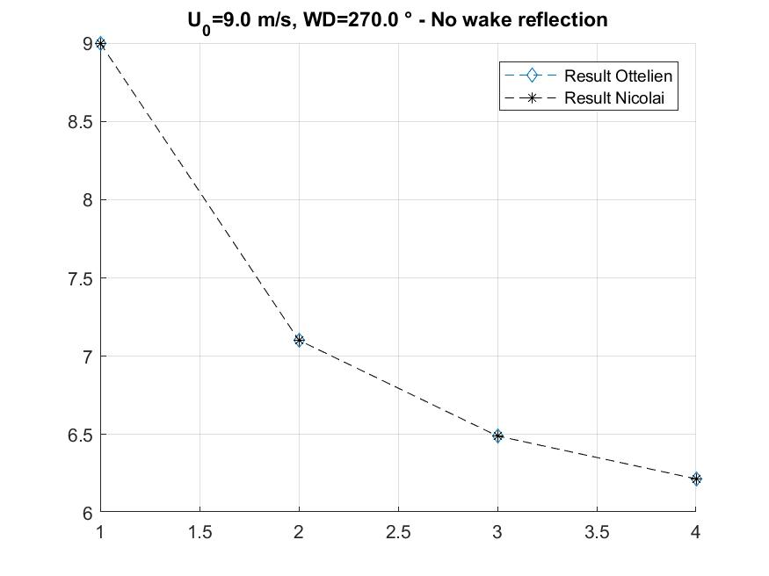
1. Park model: test case

Slide 4
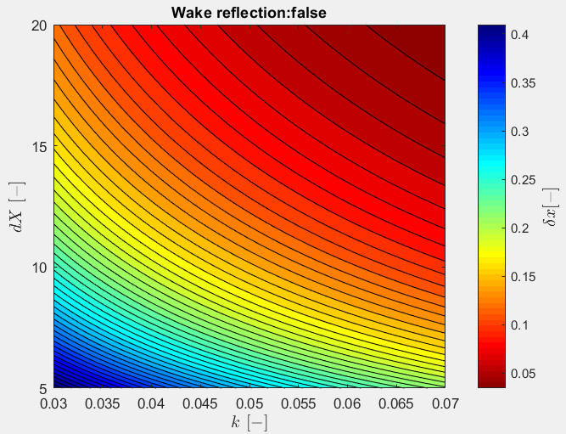
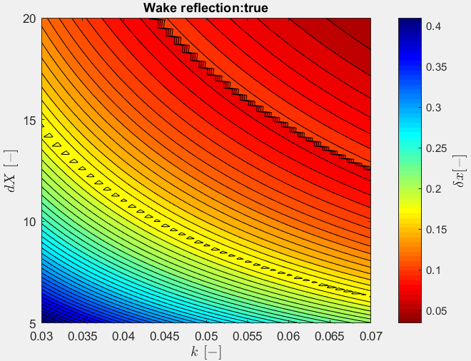
Sensitivity study (CASE C)
Parameter
U0 | 10 m/s
Wake coefficient k | Variable
Wind turbine distance | Variable
Superposition method | Quadratic
Correction factor | True
Wake reflection | False/True
CT curve | WMR
Wind speed deficit at 3rd wind turbine

Slide 5
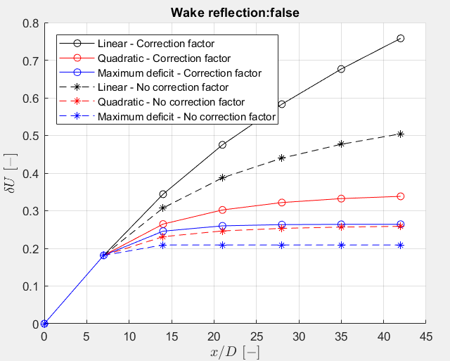
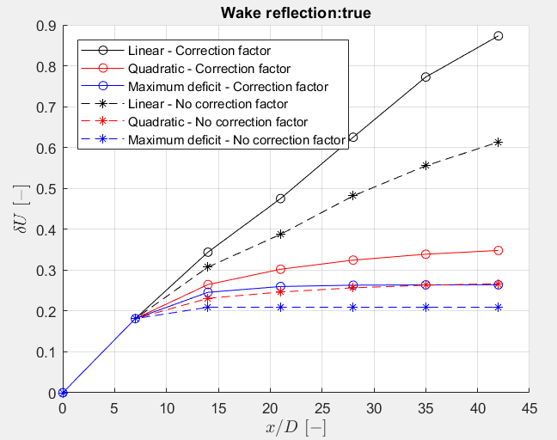
Sensitivity study: CASE B
Parameter
U0 | 10 m/s
Wake coefficient k | 0,04
Wind turbine distance | 7*D
Superposition method | Variable
Correction factor | False/True
Wake reflection | False/True
CT curve | WMR

Slide 6
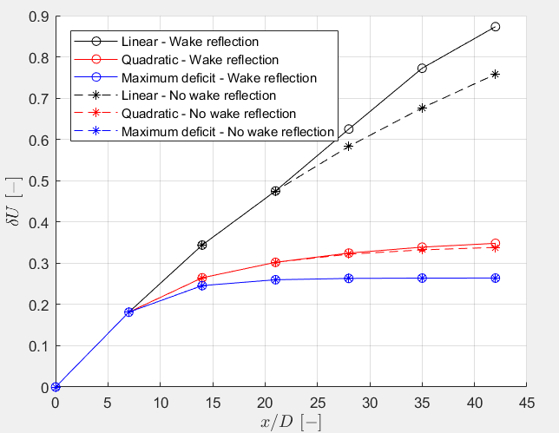
Sensitivity study: CASE A
Parameter
U0 | 10 m/s
Wake coefficient k | 0,04
Wind turbine distance | 7*D
Superposition method | Variable
Correction factor | True
Wake reflection | False/True
CT curve | WMR

Slide 7
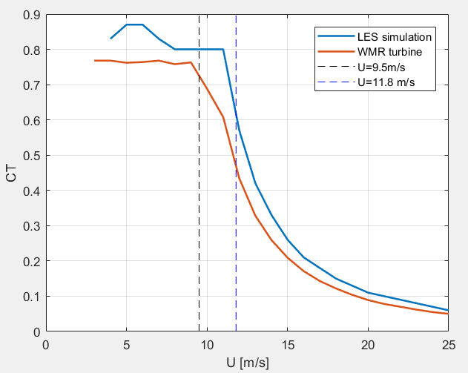
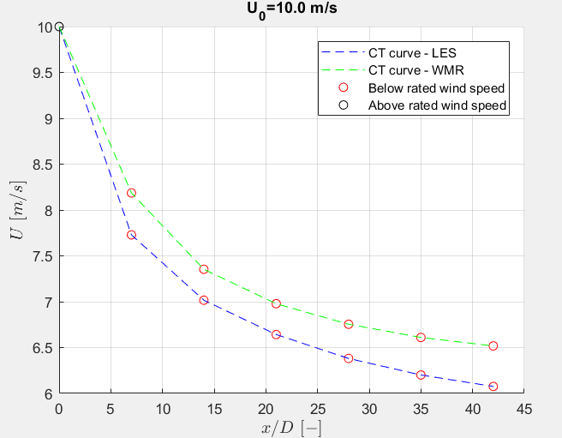
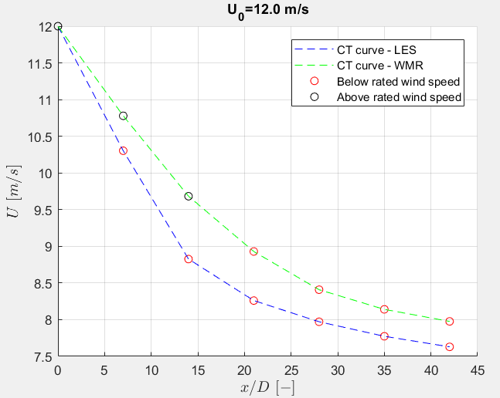
Sensitivity study CASE E
Parameter
U0 | Variable
Wake coefficient k | 0,04
Wind turbine distance | 7*D
Superposition method | Quadratic
Correction factor | True
Wake reflection | True
CT curve | Variable

Slide 8
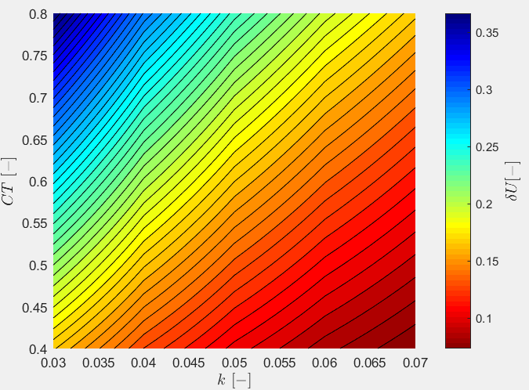
Sensitivity study: CASE D
Parameter
U0 | 10
Wake coefficient k | Variable
Wind turbine distance | 7*D
Superposition method | Quadratic
Correction factor | True
Wake reflection | True
CT curve | Variable

Slide 9
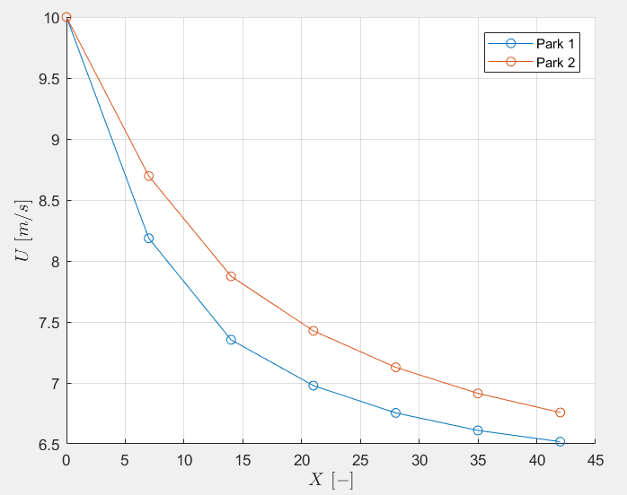
Sensitivity study: CASE F
Parameter | Park 1 | Park 2
U0 | 10 | 10
Wake coefficient k | 0,04 | 0,06
Wind turbine distance | 7*D | 7*D
Superposition method | Quadratic | Linear
Correction factor | True | False
Wake reflection | True | False
CT curve | WMR | WMR

Slide 10
LES data
Calculation of mean
Tend= 1436,1 s ≈ 23,93 min
deltaT=0,1058 s
Neglect first 300 seconds due to transient
It takes +- 300 s to reach the third wind turbine (U=11,8 m/s)
Calculate moving mean
Window = 600 s, only full windows
Umean = mean of moving mean
Ustd = std of moving mean

Slide 11
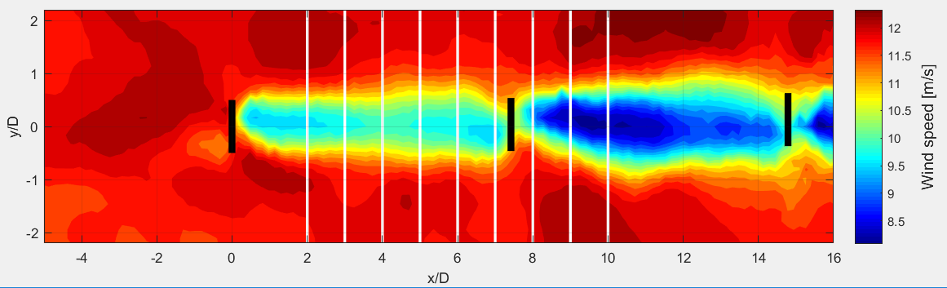
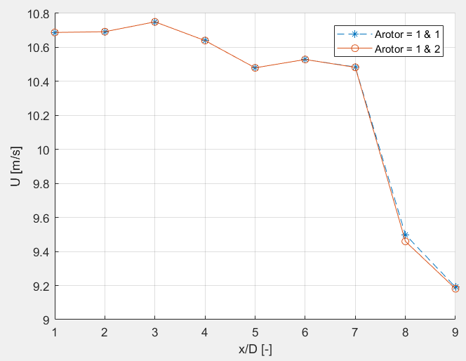
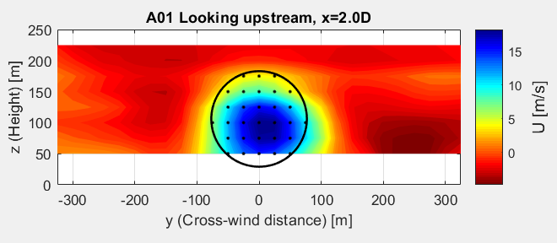
BEACon data
Rotor averaged wind speed
Change position of rotor behind second wind turbine?
No data for lower part rotor
Averaged wind speed would decrease

Slide 12
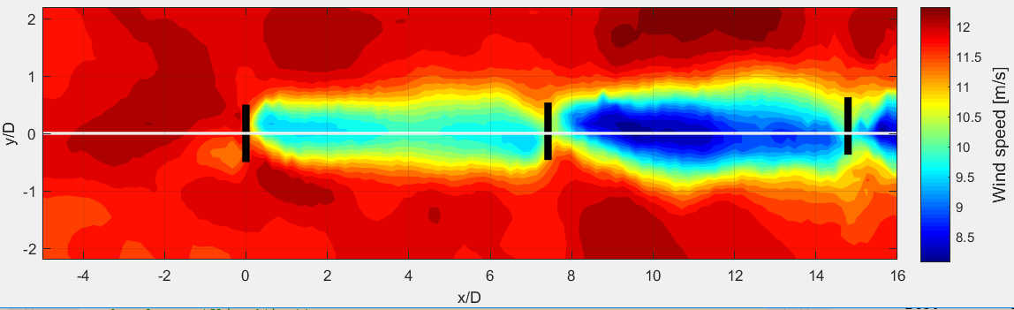
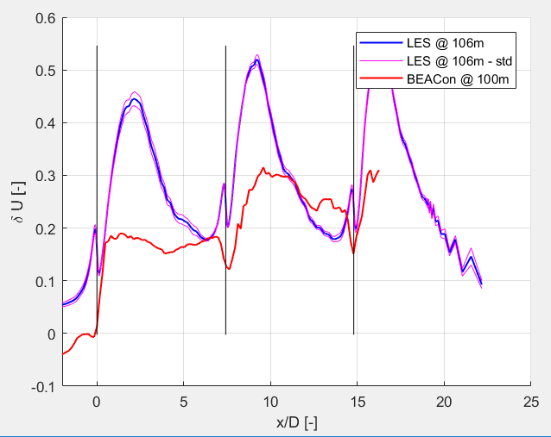
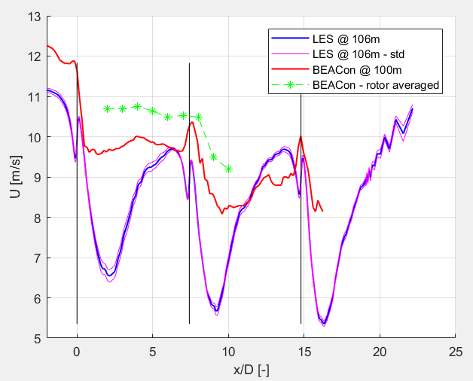
BEACon + LES data

Slide 13
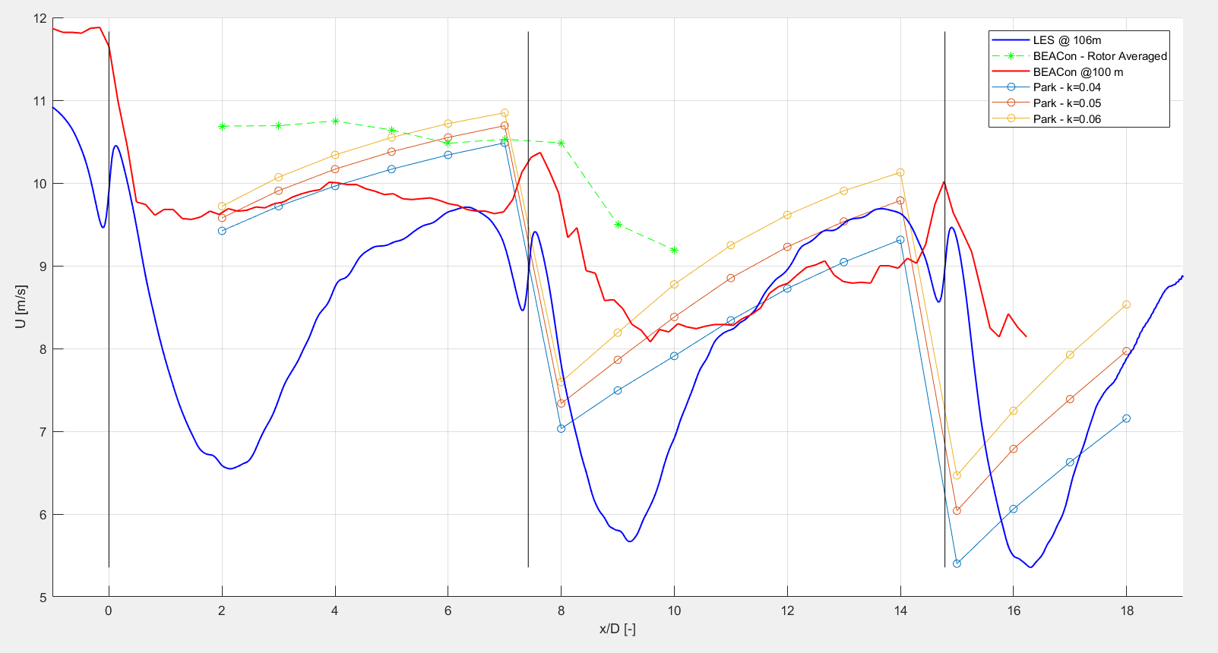
Calibration
Parameter
U0 | 11,8
Wake coefficient k | Variable
Superposition method | Quadratic
Correction factor | True
Wake reflection | True
CT curve | WMR

Slide 14
Calibration
Parameter
U0 | 11,8
Wake coefficient k | Variable
Superposition method | Quadratic
Correction factor | True
Wake reflection | True
CT curve | WMR

Slide 15
Next steps
Calibration
WAsP results

